Slide 1
So you want to be a Hacker?
Maybe not yet, but you will at the end of the hour!

Slide 2
Agenda
Introductions
Why you should listen to me
Day in the life of Joe
What makes a security tester different?
DEMOS!
Cross Site Scripting
SQL injection
Java Decomplier

Slide 3
Introduction
Joe Basirico – Dev Manager and Security Consultant for Security Innovation
Worked in security for about 6 years now
Worked for Microsoft before SI
Security Trainer, Engineer, Consultant, etc.

Slide 4






Day in the life
Work with Software, Financial, Insurance, companies to help them produce more secure software
Find Vulnerabilities in software so hackers don’t
Help our customers fix them before they release

Slide 5
The Work
One week to a couple months engagement
Quickly learn the system
Find theoretical flaws through threat modeling and intuition
Verify flaws through testing
Help client remediate the flaw directly or through recommendations

Slide 6
What makes a great hacker?
Complete Knowledge of the System
Great security testers know everything about every layer of the system, from browser to hardware
A Great Imagination
What’s really going on back there?
An Evil Streak
What’s the worst thing I could do?
Steal passwords, credit card numbers, take the system down?

Slide 7
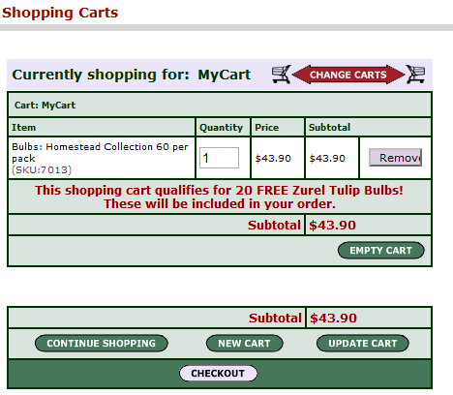
Example

Slide 8
Demos!
Cross Site Scripting
SQL Injection
Forceful Browsing
Decompilation

Slide 9
Remediation
Be very careful with your input!
Assume the world is malicious
Think like an attacker
Protect yourself

Slide 10
Questions?
E-mail
jbasirico@securityinnovation.com
Questions? Comments?

